Slide 1
LD Bell Band Boosters
July 31, 2018

Slide 2
FEE PAYMENT INFORMATION
Timely payment of fees is very important to the success of the band
Make checks payable to L.D. Bell Band
To pay by PayPal, please visit our website: ldbellband.org
Click on Members/ Parents at top Menu
Payments can also be sent by mail to: LD Bell Band, PO Box 255, Bedford, 76095.
If you need to modify or make other arrangements to fit your family’s needs, please contact the Treasurer
Communication and follow-through is key!
Contact: Ishak Sorial sorial.ldbellband@gmail.com

Slide 3
UNIFORMS
Each family cares for their student’s uniform
Cleaning instructions on uniform labels
IMPORTANT:
Please wash uniforms after each wearing!
Uniforms should always be on hangers in a garment bag
Any further questions please email Vickie Wild at whazel806@yahoo.com.
Contact: Vickie Wild whazel806@yahoo.com

Slide 4
VIPS/Volunteer/Open Positions
Everyone who volunteers in the HEB ISD must complete a background check.
Go to hebisd.edu to fill out the application to volunteer.
Keep track of your VIPS hours and log them.
Every $5 donated = 1 hour
Contact: Lisa Theisen LisaTheisen@hebisd.edu

Slide 5
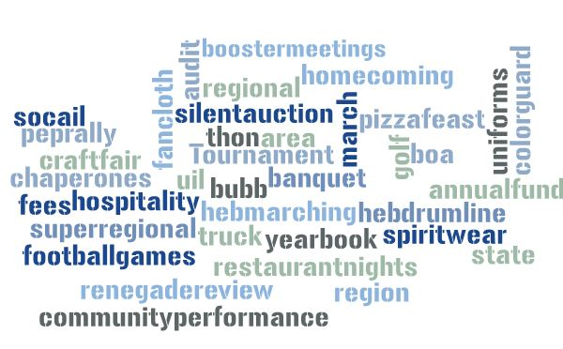

Slide 6
BUBB FUNDRAISING
Saturday, August 25
9:00 am- 1:00 pm @ Pennington
BUBB Fundraising takes electronics, sports equipment, household items, etc. in any condition. Go to bubbfundraiser.com for complete list
Laptops, gaming systems, and DVD players pay the most
Contact: Amy & Steve Campbell ldbbandpres@att.net

Slide 7
CHAPERONES
Chaperones are needed to ride the buses and assist the students and directors for football games and competitions.
Must have a current background check on file through VIPS
Contact: Tracey Boyle tracey.boyle@att.net

Slide 8
TRUCK DRIVERS
Truck drivers transport equipment to rehearsals, football games, and competitions
Must have:
Have a valid class C license
Be at least 21 years old
Have a clean driving record
Have a current HEB ISD driver background check
Contact: Marc Scherer marc.scherer@sbcglobal.net

Slide 9
March-a-thon
9/1/2018
Saturday 9/1 @ 8 AM
Individual Fund-Raiser for Students. Students collect pledges and donations. 100% of this money goes to their individual account.
Info coming home next week.
Proposed route is through Bedford
Look for needs coming soon in CHARMS
Contact: Kim Thomason kimt3125@gmail.com

Slide 10
HEB Drumline &
Marching Contests
Drumline Contest 9/15/18
HEB Marching Contest 9/28/18
BOA DFW Regional 10/6/18
Volunteers Needed! Information coming soon in CHARMS
Contact: Angela Reichert lorwan0610@gmail.com
Nick Dell
nickdell@att.net

Slide 11
Annual Fund
Corporate / Business Sponsors
Ideas & contacts needed
Tiered sponsorship levels
ldbellband.org - Sponsors
Contact: Beck Martin ldbellbandvp@gmail.com

Slide 12
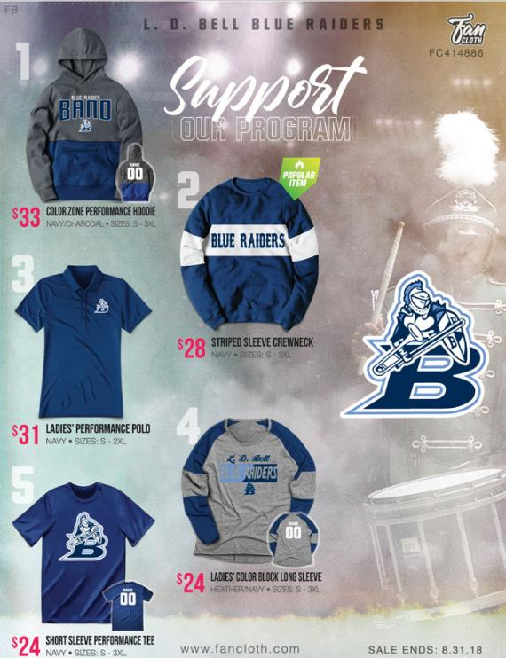
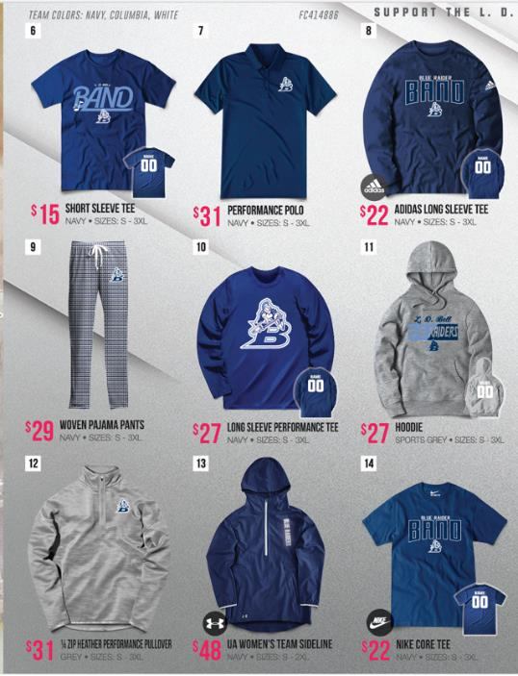
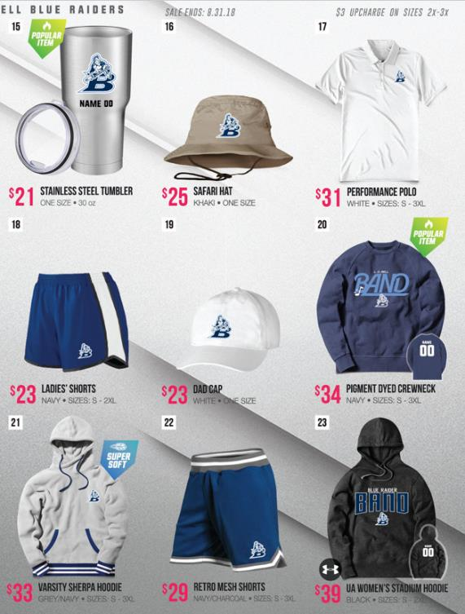
Fan Cloth Catalog
Contact: Beck Martin ldbellbandvp@gmail.com

Slide 13
Fan Cloth Fall Catalog
All orders are on-line: 1. Direct link: https://shop.fancloth.com/76054/414886
2. Order on-line using a credit card:
Use portal link via ldbellband.org:
Click on INFO and follow the link
3. Catalog opening for ordering through 8/31

Slide 14
COMMUNICATION IS IMPORTANT
http://www.ldbellband.org (calendar, contact info and links to most everything)
“Band News” emails are sent regularly. If you have not been receiving Band News, email Mrs. Dell (suzannedell@hebisd.edu)to be added to the list
Text Messages: Text “@ldbellband” to 8-1010.
Steve Campbell ldbbandpres@att.net

